Slide 1

Conduct Market Fit Research for Air Purifier Development Using AQI Analytics
Resume Project Challenge #16 Organized by Codebasics
Domain: Consumer Appliances Function: Market Research Analytics
Presented By: Amibahen Dave

Slide 2
Agenda
1. Company Overview
2. Problem Statement
3. Objectives
4. Data Overview
5. Data Model
6. Power BI Dashboard
7. Primary Analysis (Based on Available Data)
8. Secondary Analysis (Additional data and Research)
9. Recommendation

Slide 3
1. Company Overview
“AirPure Innovations” is a health-focused startup company tackling India’s air pollution crisis, with 14 Indian cities among the world’s top 20 most polluted.
The company is in early stages of developing smart air purifiers according to urban Indian conditions.
A mission is to promote healthier indoor living through data-driven innovation, AirPure is leveraging environment and behavioural data to guide strategic decisions.
The leadership team, led by COO Tony Sharma, is committed to aligning product design, R&D, and marketing with real-world pollution challenges and consumer needs. And Peter Pandey, a Data Analyst, to assist in gathering insights for strategic decisions

Slide 4
2. Problem Statement
More people in India are aware of air pollution, but “AirPure Innovations” is not sure if people will buy air purifiers in the Future.
Before spending a lot of money on research and production, the company needs to find answers to some important questions:
What pollutants or particles should their air purifier target?
What are the most essential features that should be incorporated into the air purifier?
Which cities have the highest demand for air purifiers, and what is the market size in these regions?
How can R&D be aligned with localized pollution patterns?
A lack of clarity on these questions poses a risk to resource allocation and product-market fit.

Slide 5
3. Objectives
The aims of the project is to deliver affordable, effective and intelligent air purification solutions by analysing AQI trends, Health impacts, and Consumer behaviour to Indian urban pollution patterns.
Strategic research focuses on three dimensions analysis:
Severity Mapping - Identify cities experiencing high or worsening AQI (Air Quality Index) levels to prioritize target markets.
Health Impact Correlation – Analyse the relationship between pollution exposure and public health outcomes to justify product relevance.
Demand Triggers - Examine the relationship between pollution spikes and shifts with consumer interest in air purifiers to detect seasonal or event-based demand.

Slide 6
4. Data Overview
“AirPure Innovation” is using a combination of primary and secondary datasets from Dataful platform to conduct market fit research. These datasets cover AQI data, pollution, health, population, and vehicle trends from 2022 to 2025.
Primary Dataset
AQI Data (2022 - 2025)
Indian City-level air quality index (AQI) data over time. Includes key pollutants such as PM2.5, PM10, NO₂, CO, O₃, etc. This data is used for severity mapping and identifying pollution trends.
Secondary Datasets
Health-Related Consequences
Tracks health issues linked to air pollution, such as respiratory infections, asthma, and cardiovascular cases. Help to analyse the impact of pollution on public health.
Population Projection
City-level population figures. Supports market size estimation and demand potential analysis.
Vehicle Data
Contains numbers of registered vehicles by fuel type (e.g., petrol, diesel, electric, etc). Used to explore the link between vehicle emissions and AQI.

Slide 7

5. Data Model

Slide 8
6. Power BI Dashboard

Slide 9
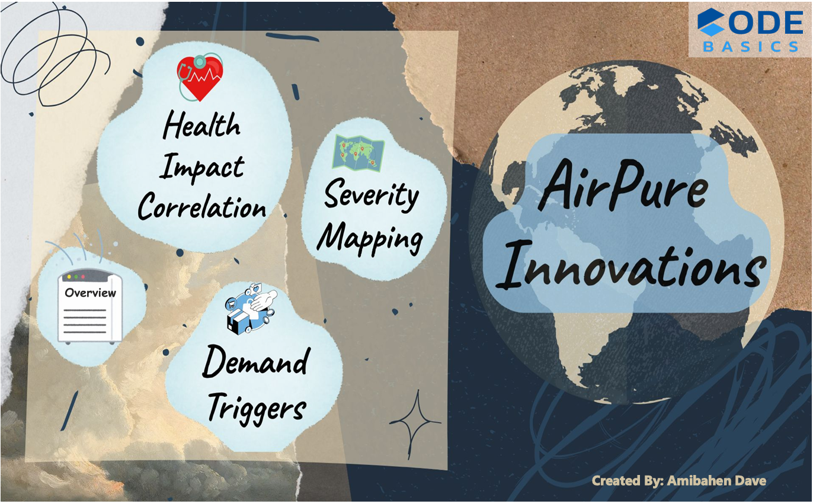

Slide 10
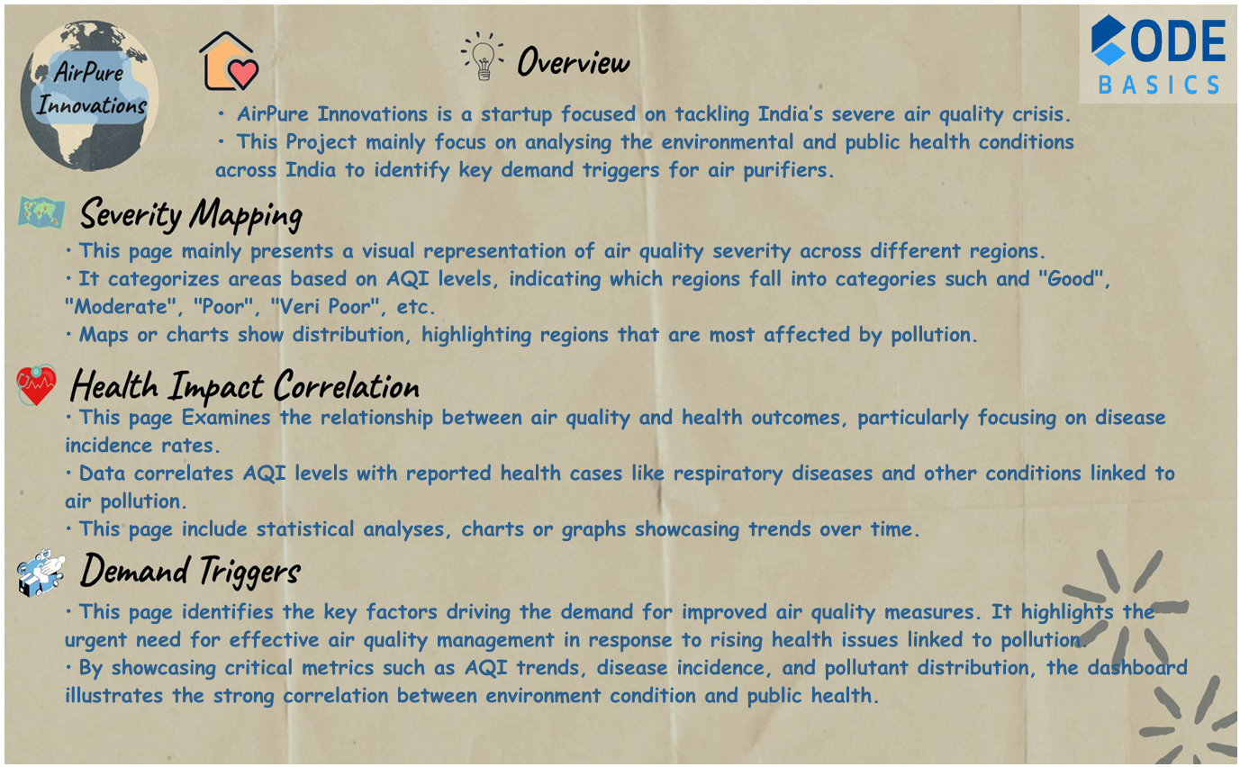

Slide 11
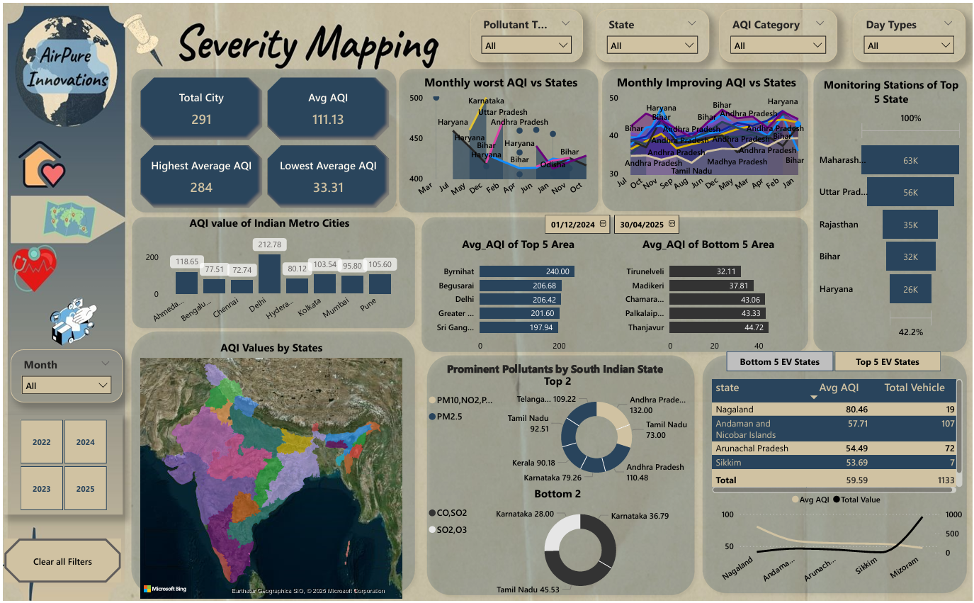

Slide 12
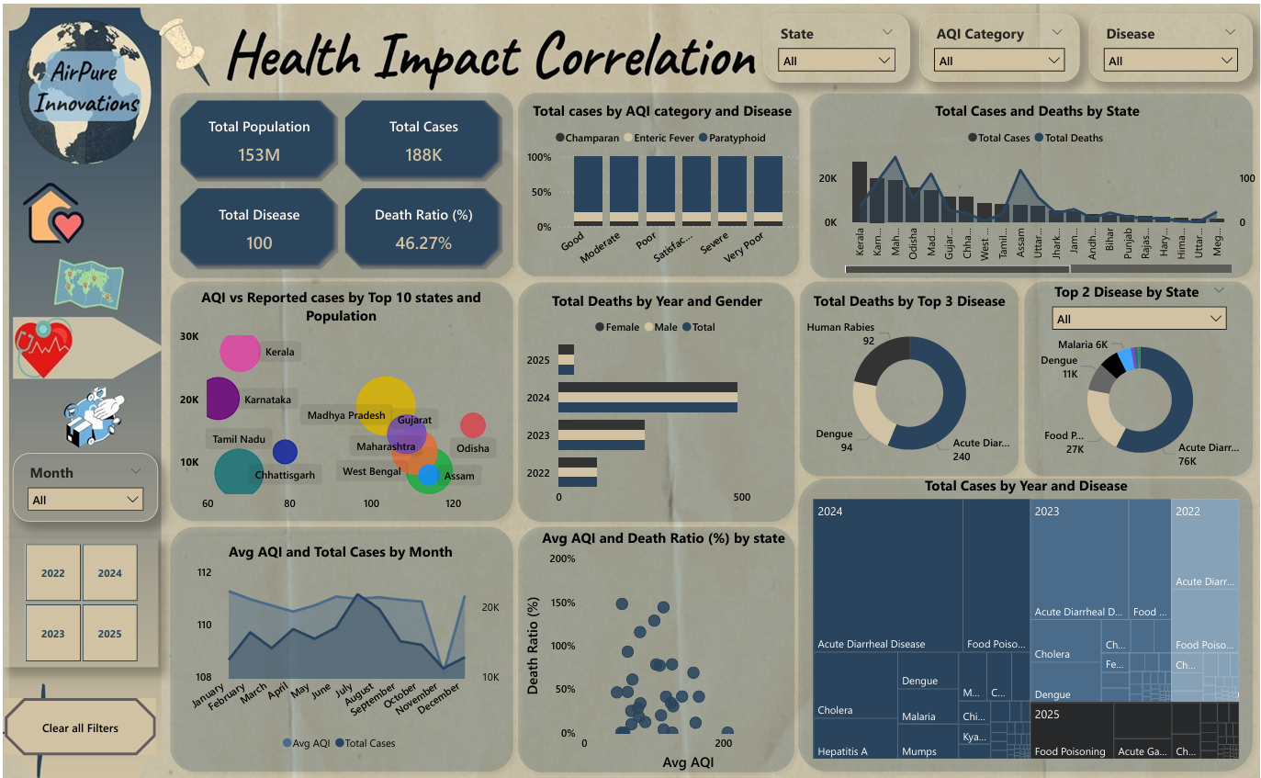

Slide 13
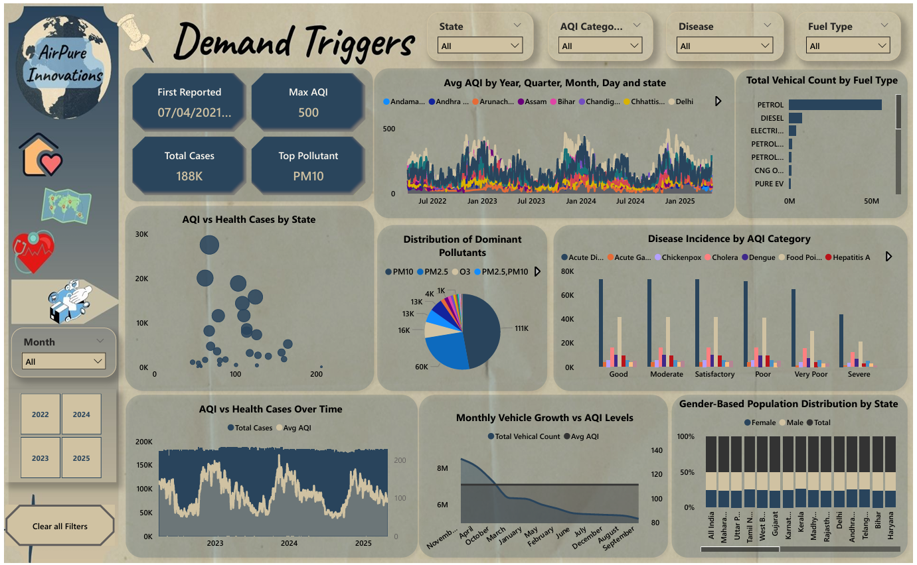

Slide 14
7. Primary Analysis (Based on Available Data)

Slide 15

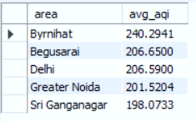
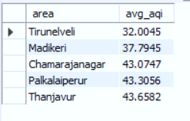
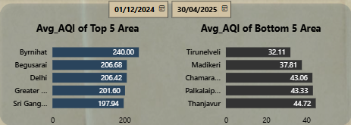
Top Bottom
List the top 5 and bottom 5 areas with highest average AQI. (Consider areas which contains data from last 6 months: December 2024 to May 2025)

Slide 16

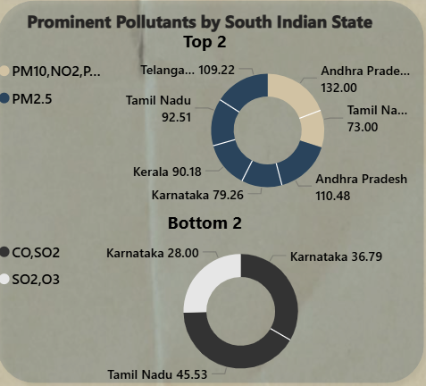
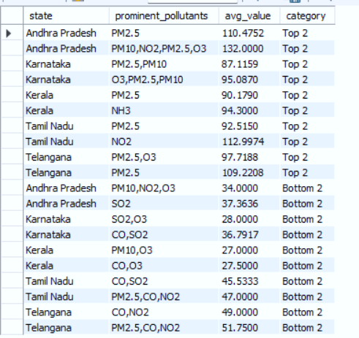
List out top 2 and bottom 2 prominent pollutants for each state of southern India. (Consider data post covid: 2022 onwards)

Slide 17
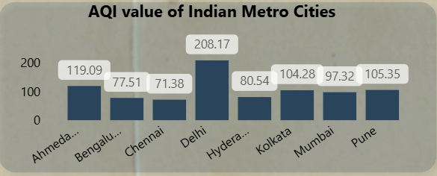
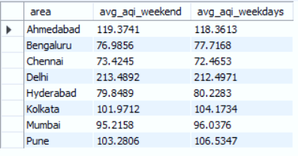
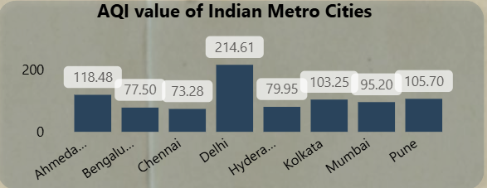
Weekend
Does AQI improve on weekends vs weekdays in Indian metro cities (Delhi, Mumbai, Chennai, Kolkata, Bengaluru, Hyderabad, Ahmedabad, Pune)? (Consider data from last 1 year)
Weekdays

Slide 18
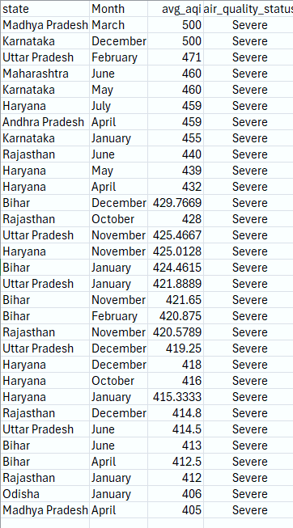
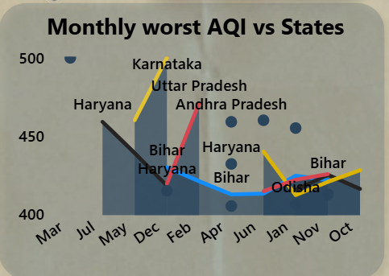
Which months consistently show the worst air quality across Indian states — (Consider top 10 states with high distinct areas)

Slide 19

For the city of Bengaluru, how many days fell under each air quality category (e.g., Good, Moderate, Poor, etc.) between March and May 2025?

Slide 20
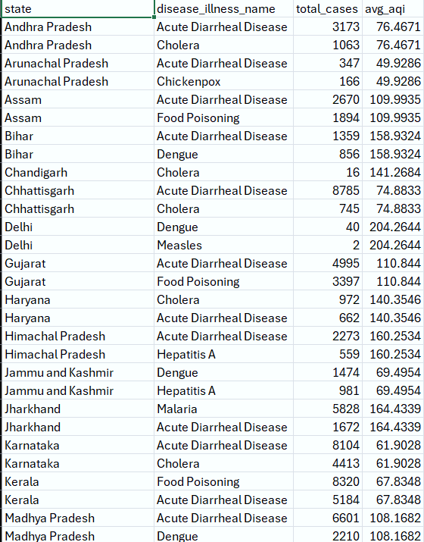
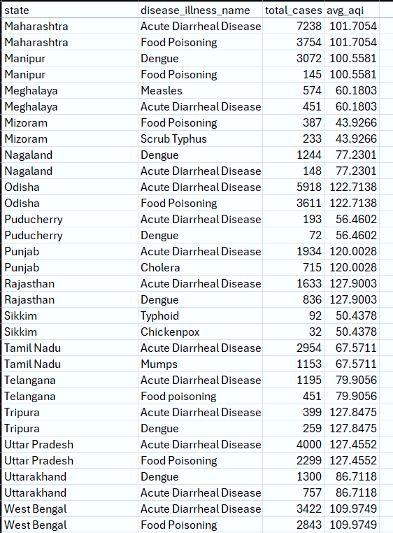
List the top two most reported disease illnesses in each state over the past three years, along with the corresponding average Air Quality Index (AQI) for that period.

Slide 21
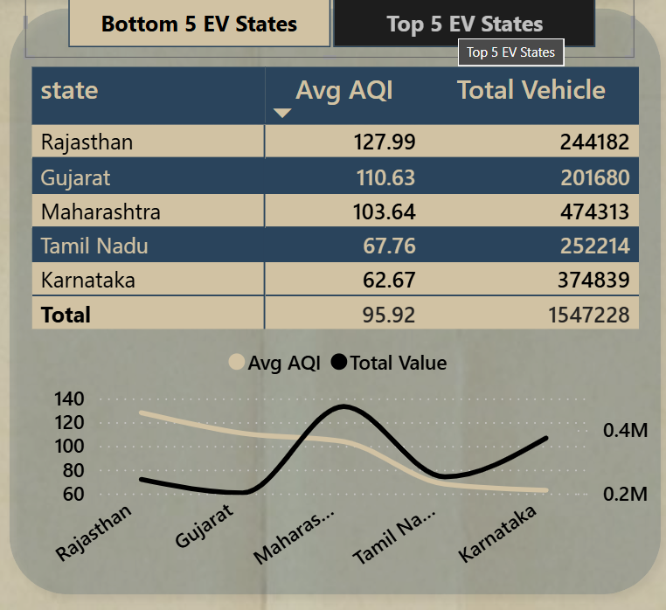
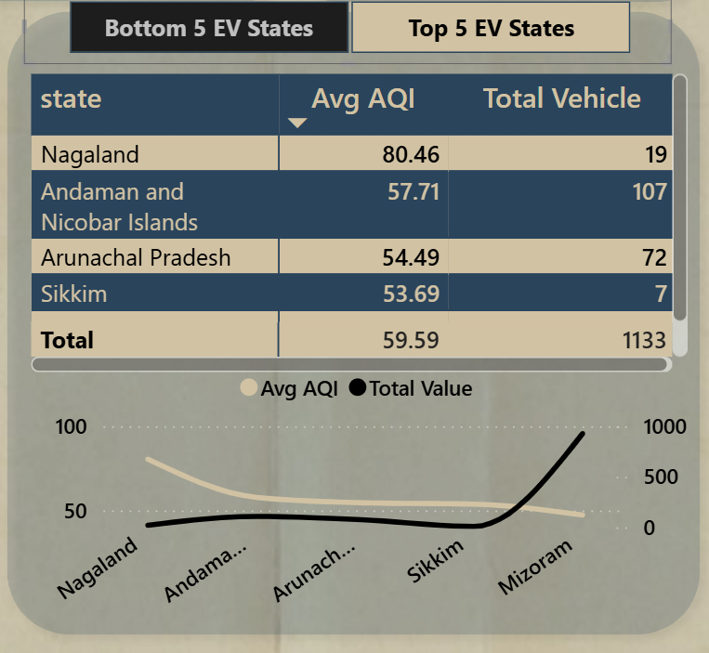
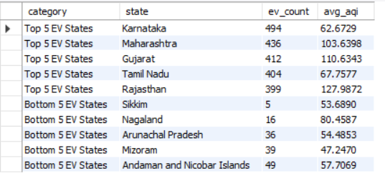
List the top 5 states with high EV adoption and analyse if their average AQI is significantly better compared to states with lower EV adoption

Slide 22
8. Secondary Analysis
(Additional data and Research)

Slide 23
Which age group is most affected by air pollution-related health outcomes — and how does this vary by city?
According to WHO (World Health Organization) Children, elderly and pregnant women are more affected by air pollution-related diseases.
Urban and Rural areas are also affected by air pollution especially those with high traffic density and industrial activity have higher levels of air pollution.
Different cities have varying levels of air pollution due to industrial activity, transportation and weather. For example, Delhi is major metropolitan area face severe air quality challenges, while some smaller cities may have relatively better air quality.
Who are the major competitors in the Indian air purifier market, and what are their key differentiators (e.g., price, filtration stages, smart features)?
There are various competitors in the Indian air purifier market, but major competitors are Dyson, Phillips, Mi (Xiaomi), Honeywell, Sharp, Kent, LG, Samsung, Blue Star, and Realme.
If in terms of price Mi and Realme give affordable price with HEPA filters and app control.
Phillips and Honeywell offer multi-stage filters with middle range price.
In terms of advanced and smart filtration Dyson offer premium quality.
LG and Samsung provide stylish and high-tech purifier.

Slide 24
What is the relationship between a city’s population size and its average AQI — do larger cities always suffer from worse air quality? (Consider 2024 population and AQI data for this)
Generally large city with large population have worst average AQI due to transportation, open burning and industrial activity like Delhi, Mumbai and Kolkata, but this is not always the case, for example some larger cities like Bangalore or Hyderabad had comparatively better AQI because of better urban planning, favourable weather.
There are many small cities like Kanpur or Ghaziabad had very poor air quality with smaller population because cities pleased near by industrial zone.
As per the 2024 report, Delhi had approximately 33.8 million population with worst annual AQI around 209
How aware are Indian citizens of what AQI (Air Quality Index) means — and do they understand its health implications?
Recent years, the awareness of the Air Quality Index has improved, especially in metro cities such as Delhi, Mumbai and Bangalore. They know of air pollution but limited aware of detailed understanding of the Air Quality Index and its health implications.
Some people in cities like Delhi and Mumbai often check AQI through mobile app or news, but some do not fully understand how different AQI levels affect health.
The people who come from middle- and upper-income groups can correctly understand AQI categories like Poor and Hazardous and even fewer take specific precautions like wearing masks.
On the other hand, rural communities and low-income urban area awareness of AQI is very low, they only recognize pollution only through visible dust and breathing difficulty.

Slide 25
Which pollution control policies introduced by the Indian government in the past 5 years have had the most measurable impact on improving air quality — and how have these impacts varied across regions or cities?
The Indian Government introduced various policies in the past 5 years, but there are some key policies that impact more.
“National Clean Air Programme (NCAP)” launched in 2019. The aim of this policy was to reduce PM2.5 and PM10 by 20-30% by 2024, and by 2026 expected 40%. Recent report of 2024-2025, as compared to 2017-18 PM10 saw reduction , Mumbai led metros with a 44% drop. Some cities archived dramatic declines like Dhanbad (~81%) and Varansi (~68%).
“Bharat Stage VI Emission Standards (BS-VI)/ Vehicle Policies” introduced in April 2020 marked a significant step in curbing vehicle pollution. BS-VI fuel has lower sulphur content and mandates cleaner engine technology.
“Emission Trading Scheme (ETS) in Surat (Gujarat)” in partnership with the Gujarat Pollution Control Board (GPCB) and J-PAL South Asia was launched in 2019. This is market-based approach allowed industries to trade emissions permits and proved to be highly cost-effective — reducing particulate pollution by around 20–30% while improving compliance rates. The ETS has since been expanded to Ahmedabad and is being studied for replication in other industrial cities.

Slide 26
9. Recommendation
Target High-Pollution Cities First :- Prioritize product launch in cities with high AQI levels such as Delhi, Ghaziabad, Kanpur, and Lucknow.
Design Air Purifiers for Indian Pollution Profiles :- Focus on filtering PM2.5, PM10 and NO₂ , the most common harmful pollutants in Indian urban air. Include multi-layer HEPA filters, activated carbon and real-time AQI sensors.
Leverage Demand Spikes During Pollution Seasons :- Use past AQI data to anticipate seasonal demand peaks e.g., Diwali. Run targeted campaigns during these periods to boost adoption.
Focus on Populated and High-Risk Area: - Cities with both high AQI and large populations offer larger market size and impact.
Monitor Policy and EV Trends :- BS-VI and EV adoptions are helping reduce emissions in some areas, this may shift purifier demand geographically over time. Keep track of government policy changes to align distribution and R&D efforts.
Educate Consumers with AQI Awareness :- Partner with apps, hotels or local authorities to share real-time AQI and educate the public. Builds brand trust and creates awareness about the need for air purifiers.

Slide 27
Thank you

